Slide 1


Optimizing Global Safety Reporting in Clinical Trials
Eliminating Over Distribution of Safety Reports, Reducing Site Burden, Increasing Patient Safety
30-OCT-2017
Notes:
Eliminating Over distribution of Safety Reports, Reducing Site Burden, Increasing Patient Safety
Industry challenges
Roche 6 years ago
Understanding the process
Addressing the issues
Measuring our success
Where we go next
Q and A

Slide 2





Today’s Speakers
Moderator
Kristy Fusco, MLD
Product Manager, SafetyPortal
Speaker
Kendra Hayden
Global Process Owner,
Safety Document Distribution
Speaker
Steven Beales
Senior Vice President, IT
Market Owner, Safety Solutions
Notes:
Kristy to introduce herself, the speakers and the topic of today’s session
During Kendra’s Introduction, it is important to illustrate the credibility of the webinar. Some Roche successes with the adoption of the CTSP:
Launched in August 2011
Upgraded in March 2017
Over 3000 studies and 300 compounds

Slide 3
Disclaimer
The views and opinions expressed in this presentation and any related discussion(s) are solely those of the individual presenter(s) and may not express the views of and opinions of Roche.
Notes:
Kristy to mention ‘Obligatory Disclaimer’

Slide 4
What are the major challenges the industry is facing in Safety Reporting?
Lack of global harmonization in reporting rules
Determining causality
Fear of regulatory repercussions
Notes:
Firstly, I’d like to welcome the 240 people who registered for today’s webinar.
We’re all passionate about Safety Reporting. We realize how complex Global Safety Reporting is, how difficult it is to do correctly, how little appreciation we receive when we get it right and the potentially terrible consequences if we get it wrong.
We recognize Safety Reporting is the largest hidden cost in our industry, the area where most efficiency gains can be made, and an area most resistant to change. In many ways, it is still a manual process, like paper CRFs before the introduction of EDC.
Clinical Trials Transformation Initiative published an excellent paper on Sponsors' and investigative staffs' perceptions of the current investigational new drug safety reporting process in June 2017. (This paper is attached as a download). Sponsor experts, who were surveyed and interviewed, listed 1) Lack of global harmonization in reporting rules; 2) Determining causality and; 3) Fear of regulatory repercussions as their 3 greatest challenges.
For last 6 years, I’ve had pleasure of working with Kendra Hayden, the Business Lead for the Roche Clinical Trial Safety Portal. These 3 challenges were 3 of the largest we faced together and challenges that we have largely overcome. We were overwhelmed by the size of the problem when we started the project and pleasantly surprised at how much success we’ve achieved. We’d like to show others how to achieve the same results.
Over to Kristy to ask Kendra “Where was Roche 6 years ago?”
Solutions - Automation of country alerting rules, Causality Based Distribution and Quality Oversight.
Notes - Only 2/3rds of countries require full expedited safety reporting
FDA estimated 90% reduction in safety reporting when properly assessing Sponsor causality
For more information about challenges in safety reporting, please read the article entitled "Sponsors' and investigative staffs' perceptions of the current investigational new drug safety reporting process in oncology trials," published in Vol 14, Issue 3, 2017 of the journal Clinical Trials.

Slide 5
Where was Roche 6 years ago?
Over-Distribution
Fragmented Process
Resources
Multiple Interpretations of local law
Study Level Distribution
Sites/IRB/IECs
Study Teams
Monitors
Lack of Global Harmonization
Unclear rules
Accountabilities
Consistency and Application
Quality Oversight
Accountabilities
Fragmented Process
Compliance
Notes:
Kendra to explain where Roche was at the start of our relationship and what they saw as the triggers to change their approach to Safety Report Distribution
Kendra:
Started electronic distribution over 10 years ago and have been evolving our process
As per Steven summary of Industry challenges it reflects our challenges
Lack of global harmonization
Unclear rules
Is there a global rule that all countries comply with
Accountability
Who is accountable for defining or interpreting what local law is
Consistency and application
How do you keep everyone trained and informed
How do you apply these rules or decisions once made across all countries and sites
Result of overdistribition
Fragmented process
Is there a global rule that all countries comply with
Multiple interpretations of local law
Often would send everything “just in case”
Study level distribution
We work with large number of study teams, and partners and often they took it upon themselves to provides sites with safety information
Our sites on average are doing 3-4 studies often with the same compounds
Resources
Sites and IRBs
Sorting out the multiple documents and why there are discrepancies
IRB submissions, communicating with other site staff, archiving and tracking
Study Teams
Expending resources to ensure sites and IRB got the necessary information
Insourced and outsourced studies
Monitors
Tracking, reconciliation and archiving
Managing gaps manually
Quality Oversight
Accountabilities
Who is accountable to ensure sites and IRB/IEC are receiving the right information
Fragmented process
++ resources need to oversee a process that is managed multiple ways
Addressing gaps
Evidence of compliance

Slide 6
Understanding the Process
SDD Solution
Process and System fully integrated
Set up
Define Global Standards
Make all safety information available
Distribute
Key information
Study Close
Simplify archiving
Define Global alerting options
Define Country Rule
Make it easy
Site closure
Quality Oversight
Notes:
Kendra
Process development
Identified Pain points and RCA
Identified dependencies on other processes
Looked to understand why we do things
Understand triggers for starting a process and evidence to show when a process is complete
Called out tasks that are specifically related to quality
Are the right roles doing the right tasks
Identified new roles in the process
SOQS, CARR
Provided training to the new roles
Defined what quality looks like in the process

Slide 7
What has Roche done to address these issues?
Global Process
Single E2E process
All studies, countries and partners
Compound Level Distribution
1 Safety document per recipient – for all studies
Aligned Global vs Local Law
Global Standards
Safety Document Characteristics
Country Rules
Direct Distributions to the Principal Investigator
Relevant safety details up front
Training
All information is available
Key Changes
Notes:
The CTTI listed lack of global harmonization in reporting rules as the greatest challenge in safety reporting. Can you explain how Roche set out to solve this problem 2 years ago?
Why did you take the approach of building a knowledge base of country rules? Why not wait for harmonization initiatives from the likes of EUDRA?
Roche has said compound level distribution and organization is 1 of the most important parts of getting safety reporting right. Can you explain your thoughts about this and how other organizations can achieve similar results?
Making participation mandatory for all groups involved in the process, especially the CROs, to ensure that the benefits are seen

Slide 8
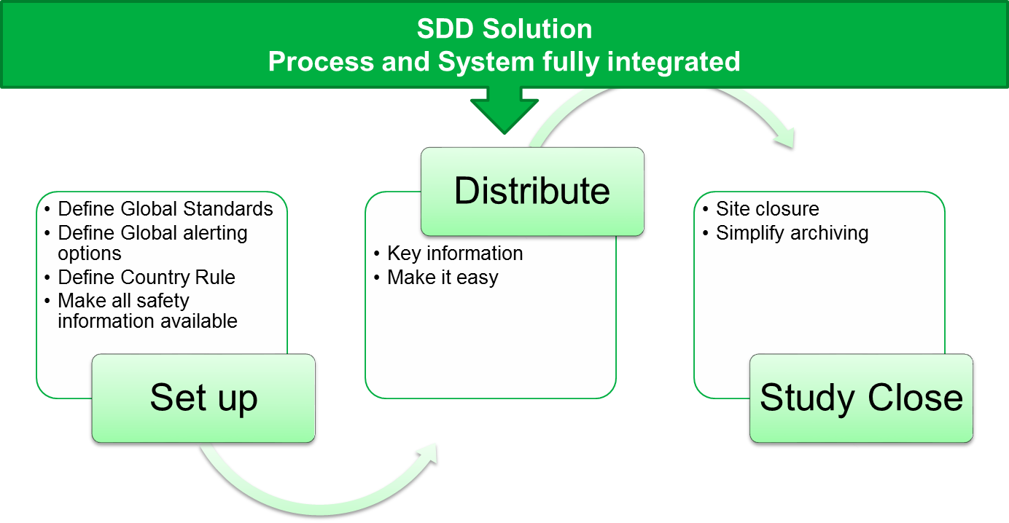
How has Roche measured their success?
Implementation and sustainment of the E2E process
Defined metrics
Target 100% trained sites
Defined exemption process
Monitor successful transmissions (<1% failed)
Monitor and analyze
65% reduction in all safety alerts transmitted over last 7 years compared to previous process
47% reduction in US safety alerts since March because of causality distribution changes
1m reduction in safety alerts per month since automating country alerting rules
Notes:
Reducing site burden is a major goal of Roche. Can you explain how you are achieving that in safety reporting by removing over distribution?
CTTI also mentioned determining causality as another major drug safety challenge. FDA has stated that expedited reporting could be reduced as much as 90% in US by implementation of 2010 final rule. Roche itself has achieved a 47% reduction since March. Can you explain why you added causality based alerting into your global rules?
Cost savings are always important in pharma as cost of new therapies rises? Can you explain what cost and labor savings you’ve seen since implementing the solution
Sites estimate an average of 2 hours required per report, single alert and acknowledgement helps to solve this. Less notifications, less to acknowledge, less site burden
In v1, for what would have been every 2.42 manual distributions, we had 1 alert (Due to compound level distribution), In v2, we have 1 alert to what would have been 4.33 manual distributions. Those 1:2.41 and 1:4.33 ratios in reduced over distribution are a credit to Roche safety reporting strategy, That means CARs gave an additional 78% reduction in Over Distribution

Slide 9
Where does Roche go next?
Continue to listen and learn
Key stakeholders, Affiliates and Regulators
Evolve and mature our process
Monitor regulatory landscape
Monitor the process
Use of analytics for process improvement
Technology
Implement enhancements
Oversight of distributions to IRB/IEC
Automate site archiving process
Support for precision medicine studies
Notes:
CTTI said that fear on non-compliance was other major challenge for sponsors. Can you explain what improvements in compliance and quality you’ve achieved at Roche in past 2 years. What do you plan for the coming year?

Slide 10
Q&A Session
Kristy Fusco, MLD
Product Manager, SafetyPortal
kfusco@epharmasolutions.com
Kendra Hayden
Global Process Owner,
Safety Document Distribution
kendra.hayden@roche.com
Steven Beales
Senior Vice President, IT
Market Owner, Safety Solutions
sbeales@epharmasolutions.com
Notes:
Kristy to introduce herself, the speakers and the topic of today’s session

